Slide 1
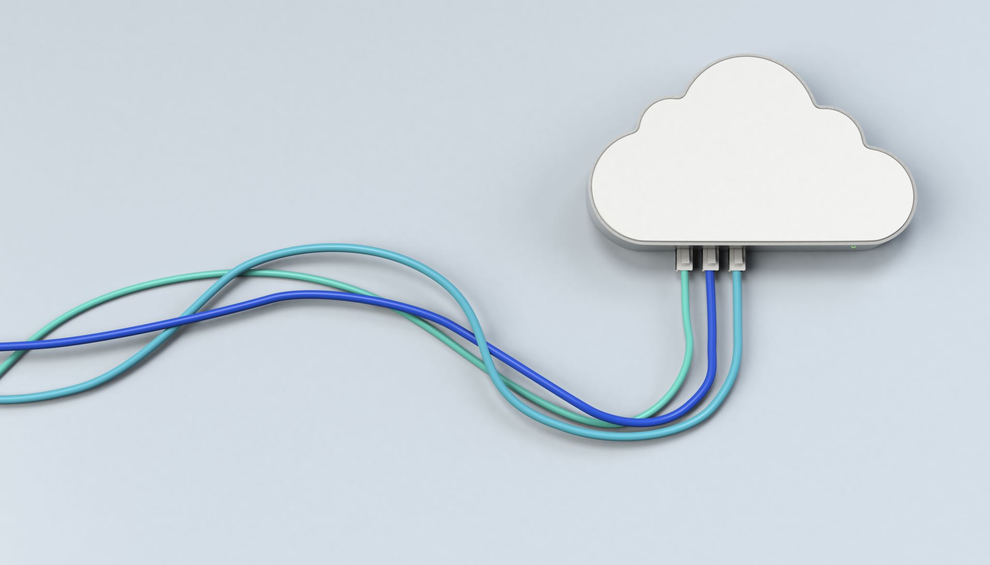
Cloud computing
Darren BOUTROS

Slide 2

What is Cloud computing?
"cloud computing is a model for enabling ubiquitous, convenient, on-demand network access to a shared pool of configurable computing resources (e.g., networks, servers, storage, applications, and services) that can be rapidly provisioned and released with minimal management effort or service provider interaction.“

Slide 3
On-demand
self-service
Rapid elasticity
Broad network access
Measured service
Essential Characteristics
Ressource Pooling
Service models
Deployment models
Notes:
you get access to cloud resources such as the processing power, storage, and network you need, using a simple interface, without requirng human interaction with each service provider.
Azure portal or Amazon console
you can access more resources and scale back when you don’t (online shop solde)
cloud computing resources can be accessed via the network through standard mechanisms and platforms such as mobile phones, tablets, laptops and workstations
You only pay what you use or reserve as you go. Resuource usage is monitored, and reported transparently based on utlization
what gives cloud providers economies of scale, which they pass on to their customers, making cloud cost-efficent. Resources dynamically assigned based on demand
one benifit of Economies of Scale - the more of an item that you buy, the cheaper it is per unit

Slide 4
Essential Characteristics:
On-demand self-service:
you get access to cloud resources such as the processing power, storage, and network you need, using a simple interface, without requirng human interaction with each service provider.
Rapid elasticity:
you can access more resources and scale back when you don’t
Broad network access:
cloud computing resources can be accessed via the network through standard mechanisms and platforms such as mobile phones, tablets, laptops and workstations
Measured service:
You only pay what you use or reserve as you go. Resuource usage is monitored, and reported transparently based on utlization
Resource pooling:
what gives cloud providers economies of scale, which they pass on to their customers, making cloud cost-efficent. Resources dynamically assigned based on demand

Slide 5
On-demand
self-service
Rapid elasticity
Broad network access
Measured service
Essential Characteristics
Ressource Pooling
Infrastructure as a Service
IaaS
Platform as a Service
PaaS
Software as a Service
SaaS
Service models
Deployment models

Slide 6
Service Models:
Infrastructure IaaS:
you get access to infrastructure and physical computing resources such as servers, networking, storage, and data center space - without the need to manage or operate them.
Platform PaaS:
Software SaaS:
software licensing and delivery model in which software and applications are centrally hosted and licensed on a subscription basis, and sometimes also referred to as "on-demand software.
you get access to the platform, that is the hardware and software tools, usually those needed to develop and deploy applications to users over the Internet.
Notes:
https://nvlpubs.nist.gov/nistpubs/legacy/sp/nistspecialpublication800-145.pdf

Slide 7
On-demand
self-service
Rapid elasticity
Broad network access
Measured service
Essential Characteristics
Ressource Pooling
Infrastructure as a Service
IaaS
Platform as a Service
PaaS
Software as a Service
SaaS
Service models
Private
Community
Public
Hybrid
Deployment models

Slide 8
Deployment Models:
Private:
the cloud infrastructure is provisioned for exclusive use by a single organization. It cloud be owned, managed, and operated by a service provider
Community:
the cloud infrastructure is provisioned for exclusive use by a specific community of consumers from organizations that have shared concerns. It cloud be owned, managed, and operated by a service provider
Public:
leverage cloud services over the open internet on hardware owned by the cloud provider, but its usage is shared by other companies
Hybrid:
mix of both public and private clouds, working thogether seamlessly

Slide 9
Public Cloud Deployments
Benefits
Easy to manage.
Disadvantages
Less control
Cost.
Performance and reliability
Privacy and security.
Simple Environments

Slide 10
Private Cloud Deployments
Benefits
Increased control
Customization.
Performance and reliability.
Disadvantages
Cost
Learning curve

Slide 11
Community Cloud Deployments
Benefits
Cost saving
Security between tenants
Enhanced collaboration.
Disadvantages
Technical requirements
Data isolation
Rarity

Slide 12
Hybrid Cloud Deployments
Benefits
Flexibility
Scalability
Disadvantages
Cost
Data silos
Rarity

Slide 13
Virtualization
Enables the hardware resources of a single computer—processors, memory, storage and more—to be divided into multiple virtual computers, called virtual machines (VMs).
Transforms hardware into software
Allows to run multiple OS as virtual machines
Benefits of virtualization
Resource efficiency: enables maximum utilization of the physical hardware’s computing capacity.
Easier management: the ability to move, copy, and isolate VMs
Availability: the ability to snapshot, clone, and run redundant VMs
Security: isolation of VMs and applications
A hypervisor, also known as a virtual machine monitor or VMM, is software that creates and runs virtual machines (VMs). A hypervisor allows one host computer to support multiple guest VMs by virtually sharing its resources, such as memory and processing.
Notes:
Computers have a tons of processing including super fast CPU speeds, fast RAM that’ inexpensive and tons of storage capacity
Is the hardware are used efficiently? Unfortunatley no when the hardware and processing power is underutilized and the electricity is wasted

Slide 14
Virtualization
two types of hypervisors:
Type 1 or “bare-metal” hypervisors interact with the underlying physical resources, replacing the traditional operating system altogether.
Type 2 hypervisors run as an application on an existing OS.
VM
VM
VM
Drivers
APP A
APP C
APP
APP A
APP B
APP C
OS
OS
OS
Operating System (OS)
Hypervisor
Infrastructure
Infrastructure
Non virtualized computer
virtualized computer

Slide 15
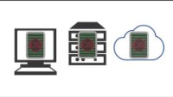
Virtualization

Slide 16
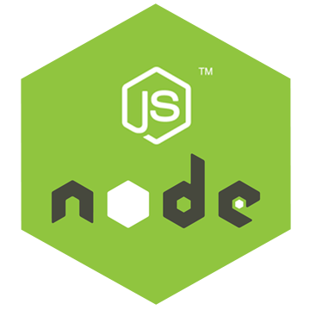
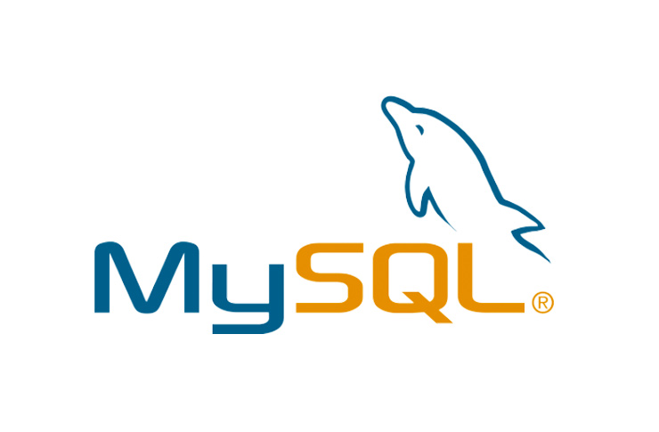
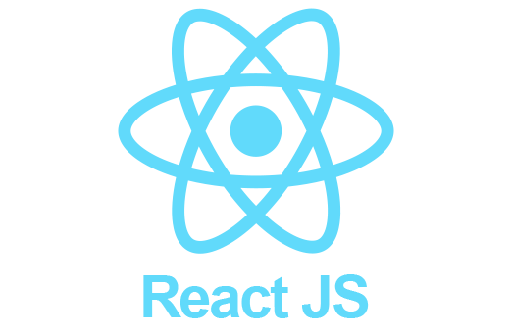
Containers
A container is a standard unit of software that packages up code and all its dependencies, so the application runs quickly and reliably from one computing environment to another.
A Docker container image is a lightweight, standalone, executable package of software that includes everything needed to run an application: code, runtime, system tools, system libraries and settings.
Libs
Dep
Libs
Dep
Libs
Dep
Librairies
Dependencies
Docker Engine
Operating System (OS)
Operating System (OS)
Infrastructure
Infrastructure

Slide 17
Containers benfits
 | Traditional | containers
Installation | Time Consuming Multiple commands | ☺
Software Dependencies | Strong Dependency | ☺
Packaging | Not Easy | ☺
Dev -> Stage -> Prod -> shipping | Duplicate Efforts Compatibility issues | ☺
Isolation | Not Possible | ☺
Scalability | Not Easy | ☺

Slide 18
Virtualization Vs Containers
VM
VM
VM
Drivers
APP A
APP C
APP
Containerized application
APP A
APP B
APP C
OS
OS
OS
APP
APP
APP
Operating System (OS)
Docker Engine
Hypervisor
Operating System (OS)
Infrastructure
Infrastructure
Infrastructure
Non virtualized computer
virtualized computer

Slide 19

Container vs hypervisor
Hypervisors:
Allow an operating system to run independently from the underlying hardware using virtual machines.
Share virtual computing, storage and memory resources.
Can run multiple operating systems on top of one server (bare-metal hypervisor) or installed on top of one standard operating system and isolated from it (hosted hypervisor).
Containers:
Allow applications to run independently of an operating system.
Can run on any operating system—all they need is a container engine to run.
Are extremely portable since in a container, an application has everything it needs to run.

Slide 20
Container/hypervisor use purpose
Containers and hypervisors are both involved in making applications faster and more efficient, but they achieve this in different ways.
Hypervisors and containers are used for different purposes. Hypervisors are used to create and run virtual machines (VMs), which each have their own complete operating systems, securely isolated from the others. In contrast to VMs, containers package up just an app and its related services. This makes them more lightweight and portable than VMs, so they are often used for fast and flexible application development and movement.

Slide 21
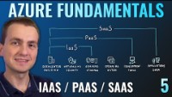
Service Models in details

Slide 22
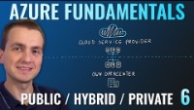
Deployment Models

Slide 23
the shared responsibility model
SaaS
PaaS
IaaS
Own data centre
Information and data
Devices (Mobile and PCs)
Accounts and identities
Responsibility
Identity and directory infrastructure
Applications
Runtime
Network controls/ middelware
Operating System
Virtualisation
Physical hosts
Physical network
Physical datacenter

Slide 24

What is serverless computing?
Like PaaS, serverless computing enables developers to build applications faster by eliminating the need for them to manage infrastructure. With serverless applications, the cloud service provider automatically provisions, scales, and manages the infrastructure required to run the code. Serverless architectures are highly scalable and event-driven, only using resources when a specific function or trigger occurs.

Slide 25
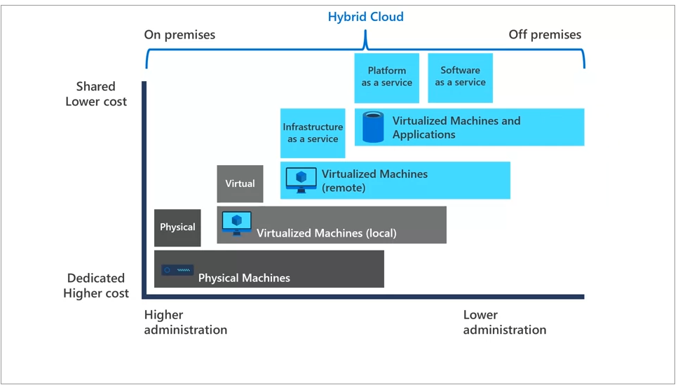
Notes:
hybrid cloud computing environments combine a public cloud and a private cloud by allowing data and applications to be shared between them. This image illustrates several of the cloud computing concepts that are presented in this unit. In this example, several factors are demonstrated when you were considering where to deploy a database server in a hybrid cloud environment. As your resources moved from on-premises to off-premises, your costs are reduced and your administration requirements decrease.

Slide 26
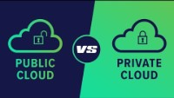
Public vs Private

Slide 27
What is cost optimization?
Cost optimization is ensuring that the money your organization spends is being used to maximum effect

Slide 28
CapEx vs OpEx spending
Capital expenditures (CAPEX) are major purchases a company makes that are designed to be used over the long term.
Operating expenses (OPEX) are the day-to-day expenses a company incurs to keep its business operational
CapEX
OpEx
New roof
Cleaning window
Cloud computing
Development
Buy Server
Licenses

Slide 29
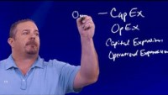
CapEx vs OpEx

Slide 30
Benefits of using cloud services
High Availability: service-level agreement SLAs
Sclability : Scalability refers to the ability to adjust resources to meet demand.
Vertical scaling is focused on increasing or decreasing the capabilities of resources.
Horizontal scaling is adding or subtracting the number of resources.
Reliability: ability of a system to recover from failures and continue to function. (décentralise design)
Predictablity
performance predictability
cost predictability: Total Cost of Ownership (TCO) or Pricing Calculator to get an estimate of potential cloud spend.
Notes:
Availability what percentage of time does a system respond properly to requests, expressed as a percentage over time

Slide 31
Benefits of using cloud services
On the security side, you can find a cloud solution that matches your security needs.
If you want maximum control of security, infrastructure as a service provides you with physical resources but lets you manage the operating systems and installed software, including patches and maintenance.
If you want patches and maintenance taken care of automatically, platform as a service or software as a service deployments may be the best cloud strategies for you.
cloud providers are typically well suited to handle things like distributed denial of service (DDoS) attacks, making your network more robust and secure.
Distributed Denial of Service attacks (DDoS) -a type of attack that originates from the Internet that attempts to overwhelm a network with millions of packets of bad traffic that aims to prevent legitimate traffic from getting through

Slide 32
Key Drivers for moving to cloud
Agility
Competitivity, Competitiveness
Flexibility

Slide 33
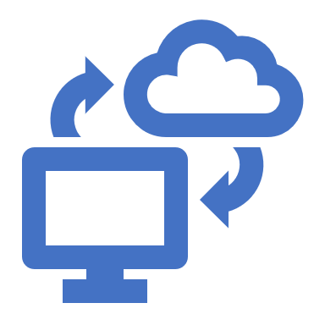
Infrastructure and Workloads
The cost of building and operating data centers can become astronomical.
Low initial costs and pay-as-you-go attributes of cloud computing can add up to significant cost savings

Slide 34

SaaS and development platforms
Leasing or paying?
Organizations need to consider if paying for application access is a more viable option than purchasing off-the-shelf software and subsequently investing in upgrades.

Slide 35
speed and productivity
Organizations also need to consider speed and productivity, what it means for them to get a new application up and running in ‘x’ hours on the cloud versus a couple of weeks, even months on traditional platforms.
Also, the person-hour cost efficiencies they gain from using cloud dashboards, real-time statistics, and active analytics.

Slide 36

Risk Exposure
and soHardwareftware or Rent by hour?
Is it riskier, for example, for them to invest in the hardware and software or rent by the hour?
Is it safer for them to work on a 12-month plan to build, write, test, and release the code if they’re uncertain about adoption?
And is it better for them to “try” something new paying-as-you-go rather than making long-term decisions based on little or no trial or adoption?

Slide 37
Benefits of cloud adoption
Flexibility
Efficiency
Strategic Value

Slide 38
Flexibility
Users can scale back or scale-up services to fit their needs
customize applications
and access cloud services from anywhere with an internet connection
help keep data secure
Virtual Private Clouds
encryption
API keys

Slide 39
Efficiency
Enterprise users can get applications to market quickly without worrying about underlying infrastructure costs or its maintenance
Cloud-based applications and data are accessible from virtually any internet-connected device
Hardware failures do not result in data loss because of networked backups

Slide 40

Strategic value
Cloud services give enterprises a competitive advantage by providing the most innovative technologies available while managing the underlying infrastructure, thus enabling organizations to focus on their priorities.

Slide 41
Challenge of cloud adoption
Data security, associated with loss or unavailability of data causing business disruption
Governance and sovereignty issues
Legal, regulatory, and compliance issues
Lack of standardization in how the constantly evolving technologies integrate and interoperate;
Choosing the right deployment and service models to serve specific needs
Partnering with the right cloud service providers
Concerns related to business continuity and disaster recovery

Slide 42
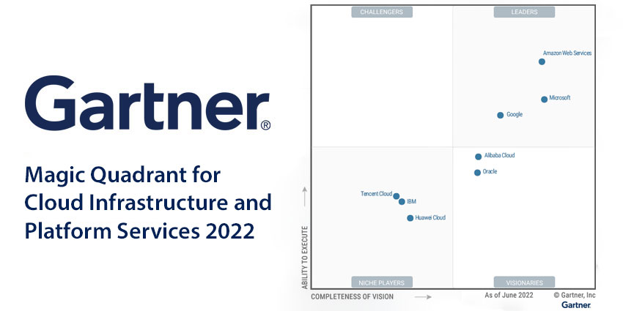
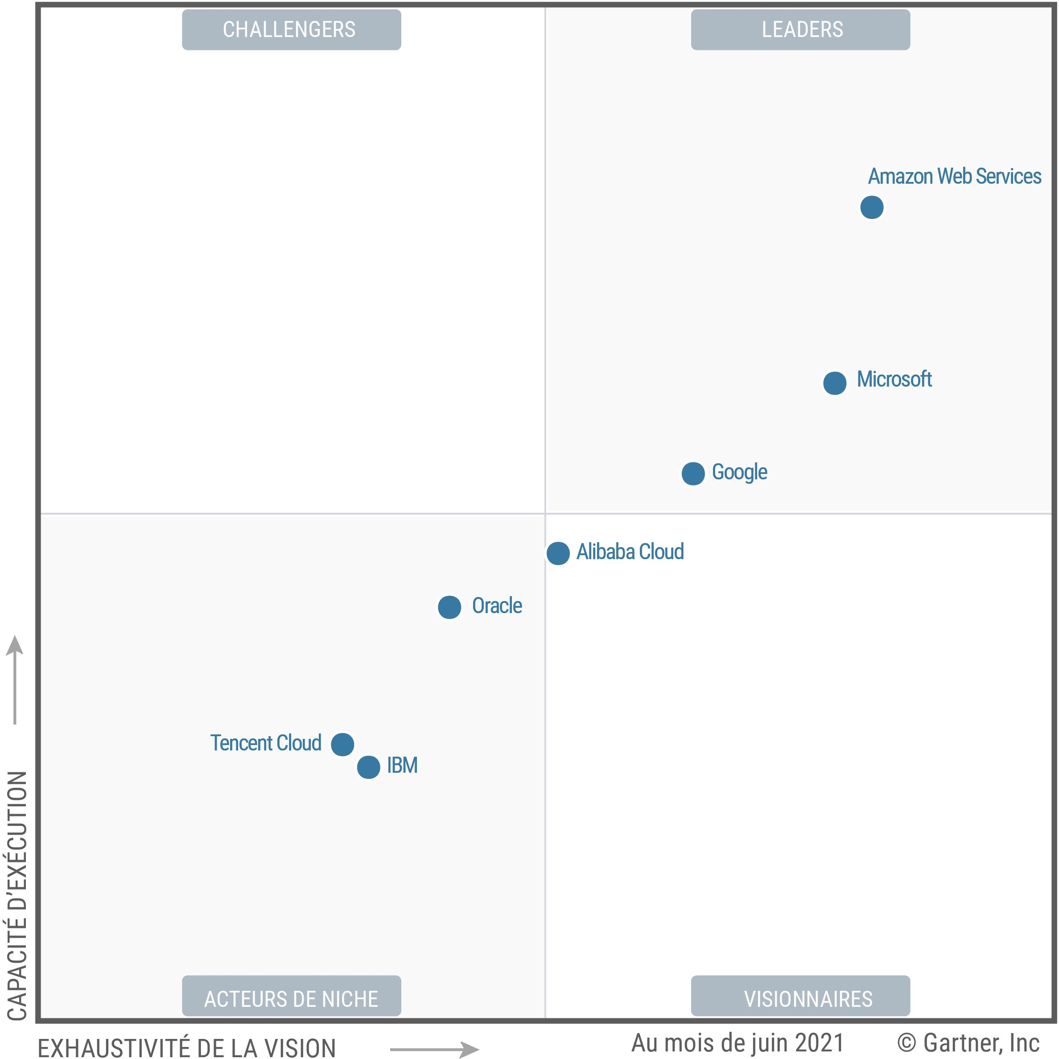
Magic Quadrant pour l'infrastructure cloud et les services de plateforme édition 2021/2022
Notes:
https://aws.amazon.com/fr/resources/analyst-reports/gartner-mq-cips-2021/
https://www.cxtoday.com/data-analytics/gartner-magic-quadrant-cloud-infrastructure-platform-services-2022/
leaders : strategic adoption with an ambitious roadmap.
Visionaries: ompanies with an ambitious vision of the future, and a strong investment in the development of unique technologies
Niche: specifically well-suited to particular use cases and regions.

Slide 43
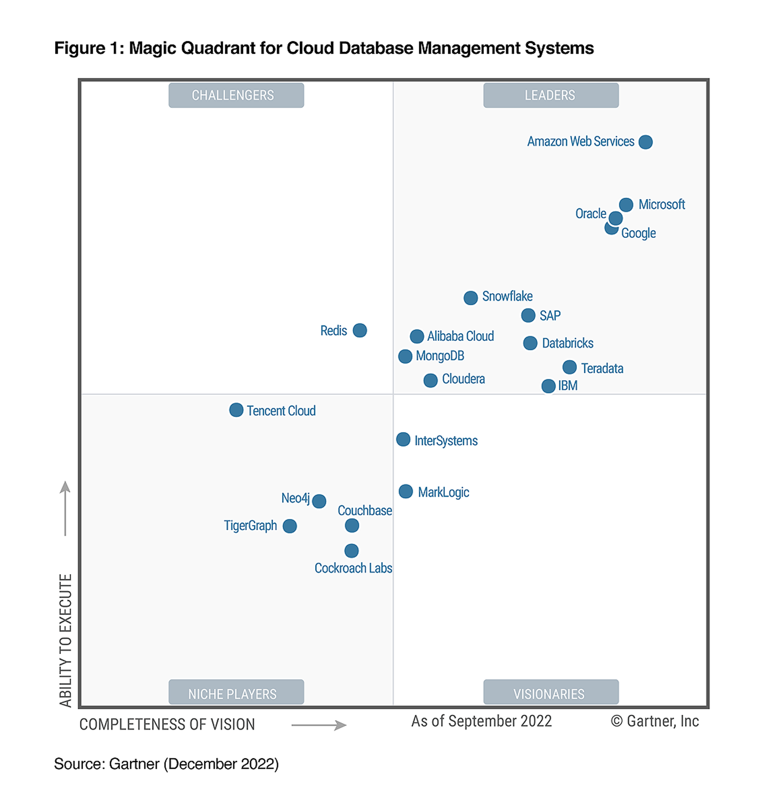
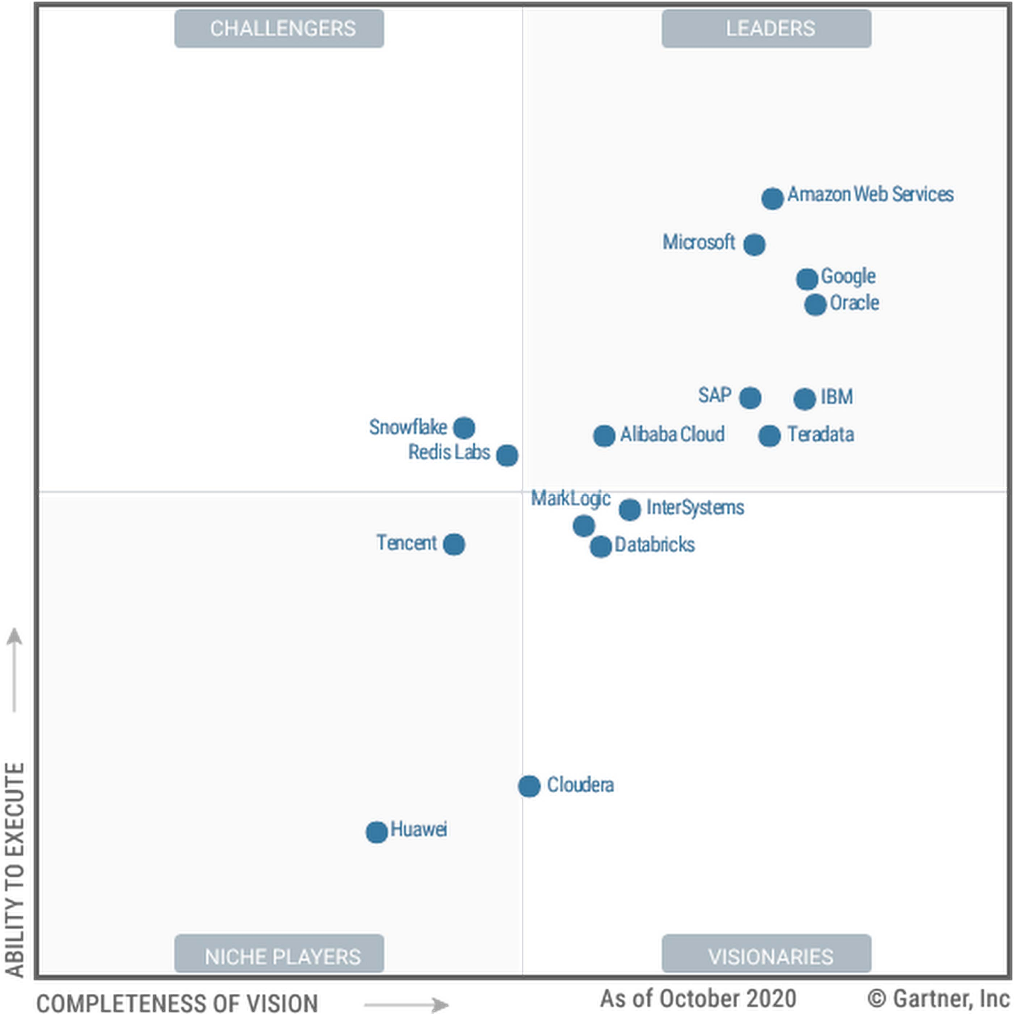
Magic Quadrant for Cloud Database Management Systems
Notes:
https://cloud.google.com/blog/fr/products/bases-de-donnees/gartner-classe-google-parmi-les-leaders-dans-son-rapport-magic-quadrant-cloud-database-management-systems-de-2020

Slide 44
QCM
The Collaboration of Private and Public cloud is
Hybrid Cloud
Cloud Engine
Community cloud
Cloud servers
In which cloud infrastructure is shared between different organizations
Private Cloud
Hybrid Cloud
Public Cloud
Community cloud

Slide 45
QCM
Which of the following are the features of cloud computing?
Security
Availability
Large Network Access
All the mentioned
Which of the following is a type of cloud computing service?
Service-as-a-Software (SaaS)
Software-and-a-Server (SaaS)
Software-as-a-Service (SaaS)
Software-as-a-Server (SaaS)

Slide 46
QCM
Which of the following type of virtualization is also characteristic of cloud computing?
Storage
Application
CPU
All of the mentioned
The technology used to distribute service requests to resources is referred to as _____________
load performing
load scheduling
load balancing
all of the mentioned

Slide 47
Microsoft (AZ-900) Certification
AZ-900 Domain Area | Weight
Describe cloud concepts | 25-30%
Describe Azure architecture and services | 35-40%
Describe Azure management and governance | 30-35%
Notes:
The higher the percentage, the more questions that part of the exam will contain

Slide 48

For question
Darren.boutros@capgemini.com

